Slide 1
Beethoven, Bach, and Brahms in Bull/Bear Markets
The Influence of Economic Health on Music Selection at the Symphony
Mark Llorente

Slide 2
Background
[Quotes from papers discussing anecdotal relationships]
[Flow Chart: larger economic indicators → budget/ expected attendance → program choice]

Slide 3
Data Sources
Symphony Selections
  New York Philharmonic Program Database
Economic Indicators
  National Endowment of the Arts
  Federal Reserve
  Federal Reserve Bank of New York

Slide 4
Our Metric: Unconventionality
Program considered unconventional if it features infrequently performed composers and pieces
  “Penalize” commonly performed works
  “Penalize” regularly played seasonal works
    e.g. Handel’s Messiah

Slide 5
Our Metric: Unconventionality
WorkTitle Unconventionality
= [WorkTitle Count in Corpus]⁻¹
Composer Unconventionality
= [Composer Count in Corpus]⁻¹
Work Unconventionality
= WU*CU
Program Unconventionality
= μ(Work Unconventionality)
Season Unconventionality
= μ(Program Unconventionality)
Unconventionality By Program
  mean: 0.0055, median: 0.00005
  std: 0.0186
  min: ~0.0, max: 0.250
Unconventionality By Season
  mean: 0.0081, median: 0.005076
  std: 0.0084
  min: 0.0003, max: 0.0047

Slide 6
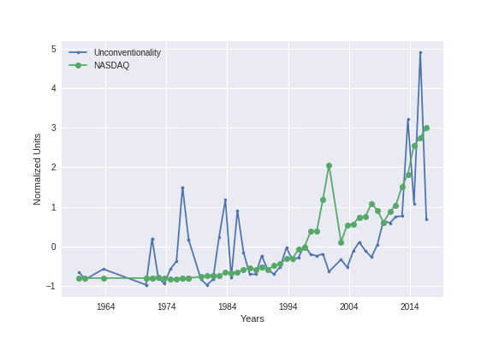
Economic Indicators and NY Phil Program Unconventionality at a Glance

Slide 7
Methods
Models:
  Random Forest
    PCA Decomposition to Minimize Redundant Splits
  Logistic Regression
Model Validation
  Time Series Split Instead of Cross Validation, Predicting Forward in Time
Scoring
  Recall
  Precision
  “F1” Average over Recall and Precision
Notes:
Linear Regression
Unconventionality and 1/Unconventionality as y-labels

Slide 8
Baseline Model vs Best Model
By Program |  |  | By Season
F1 | Recall | Precision | F1 | Recall | Precision
0.64 | 0.8 | 0.53 | 0.82 | 0.75 | 0.92
0.35 | 0.30 | 0.42 | 0.62 | 0.5 | 0.80
0.61 | 0.70 | 0.54 | 0.84 | 0.81 | 0.87
0.58 | 0.5 | 0.71 | 0.71 | 0.63 | 0.83
Baseline Logistic Regression
Baseline Random Forest
Added Delta (28 days) Columns Logistic Reg
Added Delta Columns Random Forest

Slide 9
Conclusions
Season conventionality best metric for prediction.
Changes in market affect conventionality
  Δ_{28_Days} NYC Economic Index Strongest Feature
Next Steps:
  Expand data to other cities and update unconventionality “vocabulary” and “corpus”

Slide 10
Thank You!
https://github.com/markcatalysis/ny_phil_selection

Slide 11
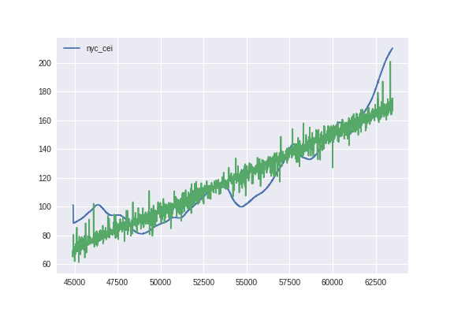
Is There Signal?
Notes:
New York City/State Coincident Economic Indicators as Labels
Counts for top Top 50 Composers
Counts for Top 1000 Pieces
Occurrence of “Small” Pieces with Smaller Orchestras (decrease overhead costs)
e.g: Concertos, Quartets, Ensemble

Slide 12
[('NASDAQCOM', 0.16310439568213458),
('DJIA', 0.044763522092463204),
('SP500', -0.26989548582145656),
('VIXCLS', 0.01235687064524414),
('FEDFUNDS', -0.91185609016088243),
(u'Total industry employment', 0.16818100040918132),
(u'Total industry compensation', 0.16818100040918088),
(u'ACPSA employment ratio', 0.16818100040918127),
(u'ACPSA compensation ratio', 0.16818100040918127),
(u'ACPSA employment', 0.16818100040918052),
(u'ACPSA compensation', 0.16818100040918066),
(u'Employment location quotient', 0.16818100040917869),
(u'Compensation location quotient', 0.16818100040918055),
('New York', 0.11239172951295938),
('NYC', 0.29660125689527428)]
[('NASDAQCOM', -0.064504261095416571),
('DJIA', -0.0087692295415448991),
('SP500', -0.35228683210836281),
('VIXCLS', 0.043248945404701443),
('FEDFUNDS', -1.1239890080714212),
(u'Total industry employment', 0.11708182767005224),
(u'Total industry compensation', 0.11708182767005244),
(u'ACPSA employment ratio', 0.11708182767005214),
(u'ACPSA compensation ratio', 0.11708182767005214),
(u'ACPSA employment', 0.11708182767005279),
(u'ACPSA compensation', 0.1170818276700521),
(u'Employment location quotient', 0.11708182767005053),
(u'Compensation location quotient', 0.11708182767005172),
('New York', -0.38049270432226601),
('NYC', 0.043838845747589651),
('NASDAQCOM_delta_28_days', -0.47321315514966295),
('DJIA_delta_28_days', 0.21287591765672692),
('SP500_delta_28_days', 0.02051316790707253),
('VIXCLS_delta_28_days', -0.46754110429464307),
('FEDFUNDS_delta_28_days', -0.22832660519234485),
(u'Total industry employment_delta_28_days', -0.11708182767005286),
(u'Total industry compensation_delta_28_days', -0.11708182767005287),
(u'ACPSA employment ratio_delta_28_days', -0.11708182767005268),
(u'ACPSA compensation ratio_delta_28_days', -0.11708182767005268),
(u'ACPSA employment_delta_28_days', -0.11708182767005239),
(u'ACPSA compensation_delta_28_days', -0.11708182767005272),
(u'Employment location quotient_delta_28_days', -0.11708182767005226),
(u'Compensation location quotient_delta_28_days', 0.11708182767005326),
('New York_delta_28_days', 0.055523169407802837),
('NYC_delta_28_days', 0.93721441667859151)]

Slide 13
Model with Added Features
[More Data Visualization]

